Slide 1
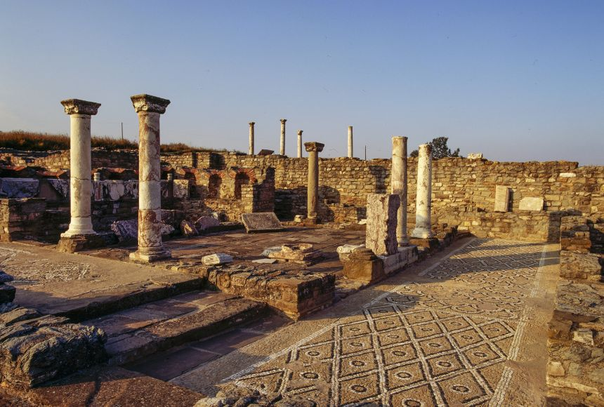
Source Analysis
Goal/s:
Analyse sources of alexander the great
Week 1 Lesson 4 – unit 2
Ms Barrie

Slide 2
ACTIVITY 1 – Watch the following video
https://www.youtube.com/watch?v=iU2IJb4GoC0&ab_channel=OverlySarcasticProductions
Watch the following video about Alexander the Great.
Take at least 10 dot-points.
(17 minutes)

Slide 3
ACTIVITY 2 – Source Analysis
Use the table to analyse the sources.
1
Read through the sources
Annotate the sources
Fill in your table

